Slide 1
English Teacher Competency Framework: An Introduction
Notes:
Hello! My name is Nguyen Ngoc Vu and I am a teacher trainer at Ho Chi Minh city University of Education. In this video, it is my big pleasure to guide you through the English Teacher Framework or ETCF for short.

Slide 2
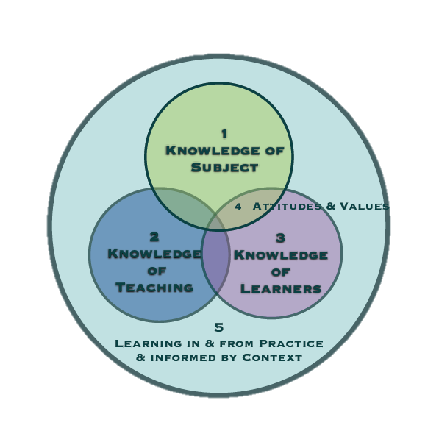
Overview
What do Vietnam’s English teachers need to know and be able to do in order to equip language learners with the skills and competencies they need for the 21st Century?
Notes:
Vietnam’s English Teacher Framework (ETCF), the first set of subject specific teacher standards in Vietnam, was created to address a key question: “What do Vietnam’s English teachers need to know and be able to do in order to equip language learners with the skills and competencies they need for the 21st Century?”. This ETCF complement general primary and secondary teacher standards issued by the Ministry of Education and Training of Vietnam.
As you can see in the illustration, Vietnam’s English Teacher Framework is based upon five domains:
1. Knowledge of subject matter and curriculum
2. Knowledge of teaching
3. Knowledge of learners
4. Professional attitudes and values embedded across knowledge domains
5. Learning in and from practice and informed by context.
Later in this video, we will see each of these domains in details but now, let’s first look at how this framework was developed.

Slide 3
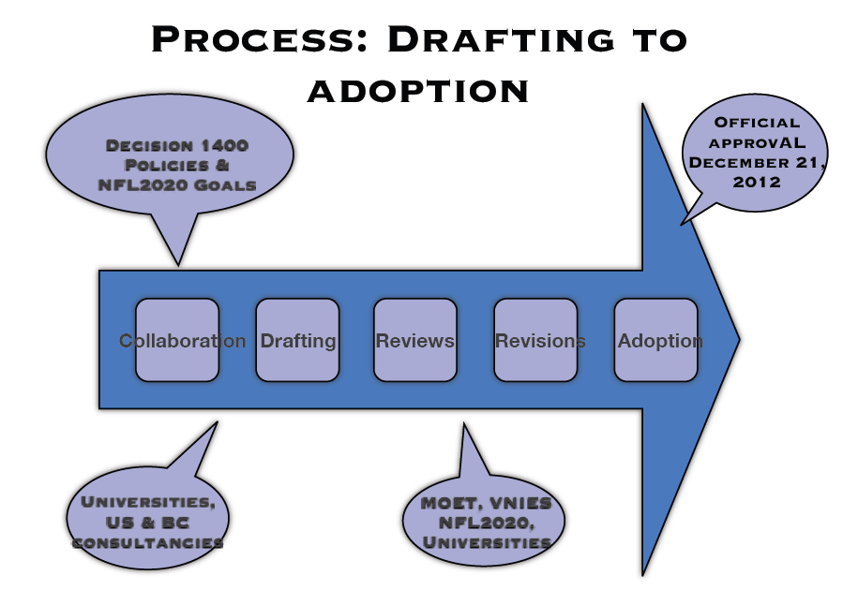
Notes:
The ETCF was started by the National Foreign Language 2020 Project in 2010.
To begin with, the framework was drafted by Dr. Diana Duzik, an international consultant from the US Department of State’s English Language Fellow Program in collaboration with leading Vietnamese English language experts from regional and national universities.
In-service teacher performance indicators were developed through a British Council consultancy in collaboration with a team of English teacher educators from throughout Vietnam.
Then, a series of national reviews were conducted by the Vietnam National Institute of Educational Sciences with participants from leading universities and international partners.
The ETCF was finally approved by a MOET panel of experts in December 2012.

Slide 4
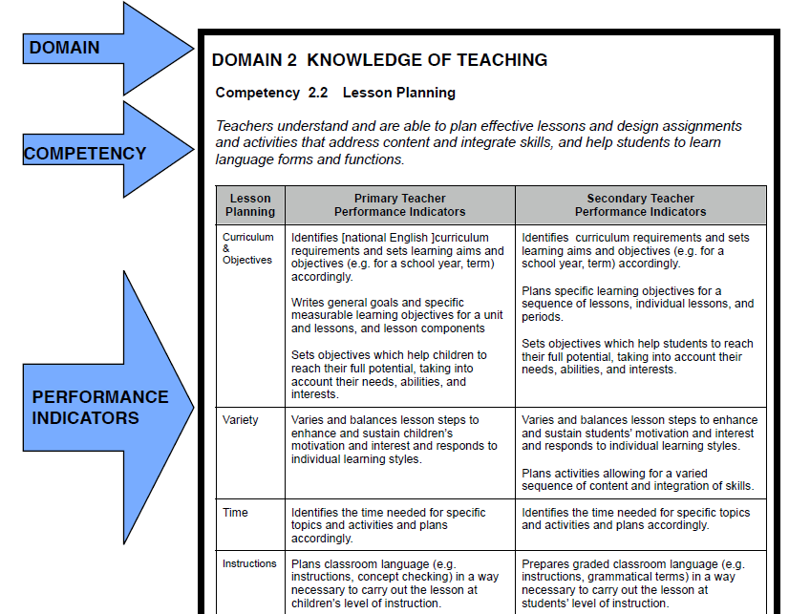
Notes:
Inside each domain, there are 2 to 6 competencies.
For example, in domain 2 “Knowledge of teaching”, we have a for Lesson planning: “Teachers understand and able to plan effective lessons”
In each , there are a number of performance indicators like these.
OK. Now let’s explore domain 1.

Slide 5
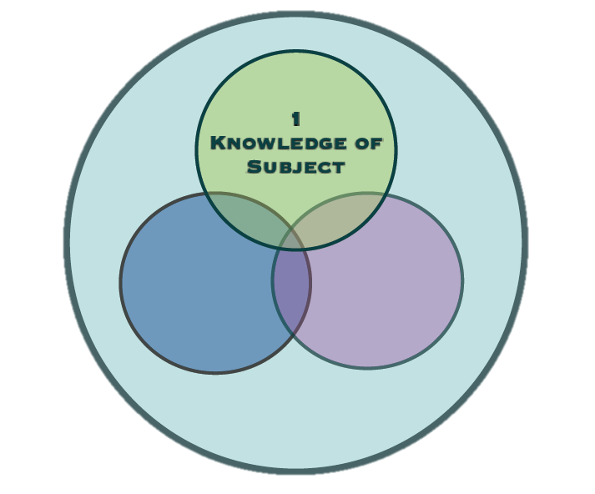
Domain 1
1.1a Teacher’s language proficiency
Notes:
Domain 1 represents subject matter knowledge for teaching.
First, teachers demonstrate proficiency in the target language at an appropriate level on the
Common European Framework of Reference (CEF) and seek opportunities to
strengthen their proficiency .

Slide 6
Domain 1
1.1a Teacher’s language proficiency
1.1b Working knowledge of CEFR
Notes:
Besides, Teachers should understand the Common European Framework of Reference proficiency descriptors
at the levels that apply to their students, and are able to apply that understanding to their
teaching practice.

Slide 7
Domain 1
1.1a Teacher’s language proficiency
1.1b Working knowledge of CEFR
1.2 Language as a system
Notes:
Secondly, teachers adequately understand English sounds, word parts, word meanings, and word order
and how to teach the language system at the primary or secondary level.

Slide 8
Domain 1
1.1a Teacher’s language proficiency
1.1b Working knowledge of CEFR
1.2 Language as a system
1.3 Understanding how languages are learned
Notes:
Thirdly, Teachers know and are able to apply knowledge about how languages are learned to
their own language learning and to their teaching.

Slide 9
Domain 1
1.1a Teacher’s language proficiency
1.1b Working knowledge of CEFR
1.2 Language as a system
1.3 Understanding how languages are learned
1.4 Cultures of English-speaking countries
Notes:
Fourthly, Teachers know and embed knowledge of target-language cultures into their teaching
and examine them in light of Vietnamese culture for understanding and empathy.

Slide 10
Domain 1
1.1a Teacher’s language proficiency
1.1b Working knowledge of CEFR
1.2 Language as a system
1.3 Understanding how languages are learned
1.4 Cultures of English-speaking countries
1.5 Academic content in English
Notes:
Fifthly, Teachers use English language literature, cultural texts, and academic texts at
appropriate developmental level to teach language and content.

Slide 11
Domain 1
1.1a Teacher’s language proficiency
1.1b Working knowledge of CEFR
1.2 Language as a system
1.3 Understanding how languages are learned
1.4 Cultures of English-speaking countries
1.5 Academic content in English
1.6 Language curriculum
Notes:
Lastly, Teachers are supposed to understand the national foreign language curriculum and are able to use
textbooks and national and local curricular objectives when planning lessons.

Slide 12
Domain 1
Notes:
So domain 1 is all about the teachers’ Knowledge of Language & Curriculum.
This domain includes teachers’ language proficiency, as well as knowledge of the language system, how languages are
learned, content and curriculum.

Slide 13
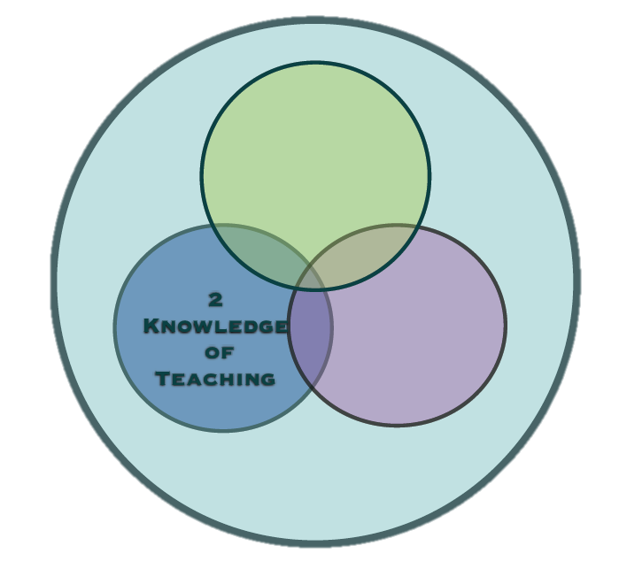
Domain 2
Notes:
Domain 2 “Knowledge of teaching” deals primarily with pedagogical content knowledge. [smile and pause]

Slide 14
Domain 2
2.1 Language teaching methodology
Notes:
The first “Language teaching methodology” require teachers to understand and are able to organize learning by using a
variety of strategies and techniques to integrate English listening,
speaking, reading and writing for authentic purposes and to address
diverse language learners.

Slide 15
Domain 2
2.1 Language teaching methodology
2.2 Lesson planning
Notes:
“Lesson planning” asks teachers to understand and able to plan effective lessons and design assignments and activities that address content, integrate skills, and help students to learn language forms and functions.

Slide 16
Domain 2
2.1 Language teaching methodology
2.2 Lesson planning
2.3 Conducting a lesson
Notes:
“Conducting a lesson” asks Teachers to know how to create a supportive, meaningful learning environment and carry out the lesson plan and manage classroom activities to give students language input,
opportunities for negotiation of meaning, and meaningful interaction.

Slide 17
Domain 2
2.1 Language teaching methodology
2.2 Lesson planning
2.3 Conducting a lesson
2.4 Assessment of language learning
Notes:
For assessment of language learning, Teachers understand formative (ongoing), and summative (progress and proficiency)
assessment tools and techniques, and are able to design and use age-appropriate
assessments to inform instruction, and to measure student progress and proficiency.

Slide 18
Domain 2
2.1 Language teaching methodology
2.2 Lesson planning
2.3 Conducting a lesson
2.4 Assessment of language learning
2.5 Resources
Notes:
With resources, Teachers are able to use and adapt required textbooks effectively for language teaching
and to locate and adapt materials and resources appropriate for students’ age and
language level.

Slide 19
Domain 2
2.1 Language teaching methodology
2.2 Lesson planning
2.3 Conducting a lesson
2.4 Assessment of language learning
2.5 Resources
2.6 Technology
Notes:
Finally, Teachers have basic computer literacy and are familiar with basic applications and uses of technology for language teaching and learning.

Slide 20
Domain 2
Notes:
So,
Domain 2 deals primarily with pedagogical content knowledge. This knowledge includes teaching the four skills, planning effective language lessons, creating supportive learning environments, conducting effective lessons, assessing students’ progress and proficiency, and using resources and technology effectively to support student learning.

Slide 21
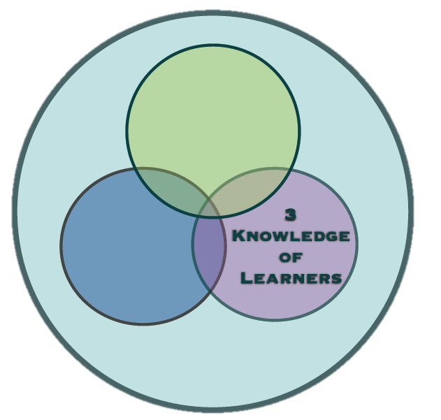
Domain 3
Notes:
Domain 3 relates to the knowledge of language learners, an often under-researched and underrepresented domain in teacher education and development. [pause & smile]

Slide 22
Domain 3
3.1 Understand learners’ development to encourage & motivate them
Notes:
Firstly, Teachers understand learners’ cognitive and affective development,
and learning styles, and develop instructional practices that address and motivate
diverse learners.

Slide 23
Domain 3
3.1 Understand learners’ development to encourage & motivate them
3.2 Recognize developmental learner language to inform instructions
Notes:
Secondly, Teachers recognize the characteristics of developmental learner language and adapt
their instruction and deal with errors appropriately for students’ stage of development.

Slide 24
Domain 3
3.1 Understand learners’ development to encourage & motivate them
3.2 Recognize developmental learner language to inform instructions
3.3 Reflect on learners’ values & prior learning
Notes:
Teachers reflect on their own and their students’ cultural values and prior learning
experiences and how they affect students’ language learning preferences and
classroom behaviors.

Slide 25
Domain 3
3.1 Understand learners’ development to encourage & motivate them
3.2 Recognize developmental learner language to inform instructions
3.3 Reflect on learners’ values & prior learning
3.4 Develop learners’ creativity & critical thinking
Notes:
Lastly, Teachers practice creativity and critical thinking in their own language learning and
teaching, and at appropriate developmental levels, help their students to develop
creativity, and critical thinking skills.

Slide 26
Domain 3
Notes:
To sum up, Domain 3 relates to the knowledge of language learners.
It is important for teachers to understand students’
development, stages of learner language, and prior learning experiences because they all contribute to successful student learning. Understanding their students is also necessary because with this understanding, teachers can develop students’ creativity and critical thinking - essential 21st Century skills.

Slide 27
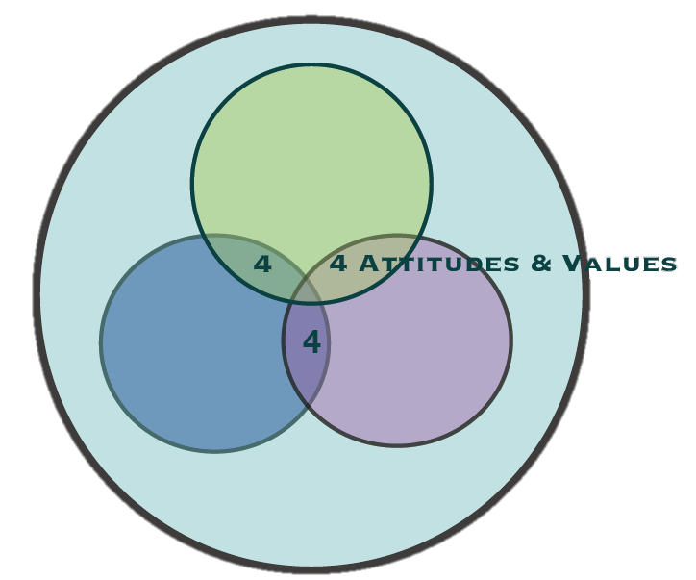
Domain 4
Notes:
Now, domain 4 is about “Professional Attitudes and Values in Language Teaching”.

Slide 28
Domain 4
4.1 Showing professionalism in language teaching
Notes:
To begin with, this domain requires teachers to know and promote the value of foreign languages for their students and
society and demonstrate professionalism in their teaching.

Slide 29
Domain 4
4.1 Showing professionalism in language teaching
4.2 Practicing cooperation, collaboration & teamwork in language teaching
Notes:
Besides, Teachers should know how to work cooperatively, and to collaborate with others in teams to
accomplish tasks, and teach students these skills in the language classroom.

Slide 30
Domain 4
4.1 Showing professionalism in language teaching
4.2 Practicing cooperation, collaboration & teamwork in language teaching
4.3 Professional development & life-long learning
Notes:
Professional Development and Life-long Learning requires Teachers to develop and practice learner autonomy, and are able to pursue current information about language teaching and research, and develop new skills and competencies

Slide 31
Domain 4
4.1 Showing professionalism in language teaching
4.2 Practicing cooperation, collaboration & teamwork in language teaching
4.3 Professional development & life-long learning
4.4 Contributing to the language teaching profession
Notes:
Lastly, Teachers pursue ongoing professional development opportunities, and contribute to the exchange of ideas within their teaching community, enhancing the quality of teaching in Vietnam.

Slide 32
Domain 4
Notes:
Please note that Professional attitudes and values are embedded throughout the other knowledge domains, as
Indicated in the illustration.
These attitudes and values include promoting and modeling language
learning; practicing cooperation, collaboration and teamwork;
demonstrating professional learning through ongoing proficiency development, reading, communities of professional
practice and peer observation, and participating in professional development activities.

Slide 33
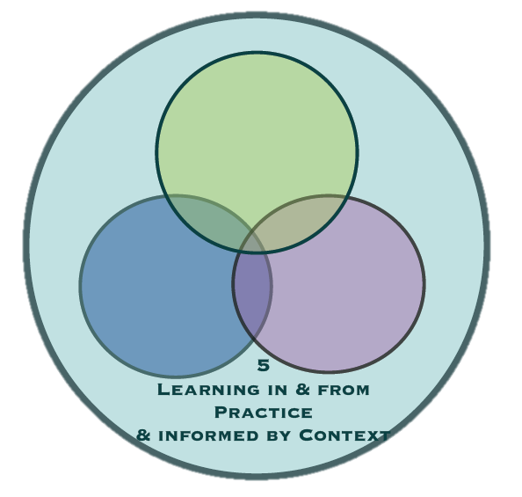
Domain 5
Notes:
Now, let’s look at the last domain of the framework “PRACTICE & CONTEXT OF LANGUAGE TEACHING”. In this domain, there are 2 competencies required for an English teacher.

Slide 34
Domain 5
5.1 Connecting learning beyond the language classroom
Notes:
“Connecting Learning Beyond the Language Classroom” demands Teachers to understand the importance of connecting their own learning and their students’ language learning to other students, classes, school, and relevant contextual issues.

Slide 35
Domain 5
5.1 Connecting learning beyond the language classroom
5.2 Reflecting on Language Learning & Teaching
Notes:
In addition, “Reflecting on Language Learning and Teaching” asks Teachers to practice ongoing reflection to examine their own language learning, and their own teaching questions, and use their findings to inform their own practice.

Slide 36
Domain 5
Notes:
In conclusion, Domain 5 represents the importance of the teachers’ understanding of context in which English is taught, and connecting the real uses of English in Vietnam to the English .This
understanding is demonstrated as teachers connect English learning to other school subjects, and relevant contextual issues related to English use; and by connecting to other English users through technology and invited speakers.
It also encourages teachers to reflect on their own
language learning, teaching questions, and pursuing answers to inform their teaching.

Slide 37
IMPLICATIONS OF THE FRAMEWORK FOR TRAINERS AND TRAINING PROVIDERS
Notes:
Right! I have briefly reviewed the five domains of English teachers’ competency framework. I hope it gives teachers like you a good overview and help you think about the kind of professional development we still need.
Now, what does ETCF means for trainers like me and training providers like my university. This will be the next part of our discussion “Implications of the framework for trainers and training providers”.

Slide 38
IMPLICATIONS OF THE FRAMEWORK FOR TRAINERS AND TRAINING PROVIDERS
Notes:
This framework is intended to be used by teacher trainers from regional centers,
universities, and other providers for teacher needs assessment, program and curriculum
evaluation, and program and curriculum improvement.
As local tools for teacher assessment and teacher training curriculums, teacher development will become more focused.
Besides, when teacher training providers map their curriculum to the ETCF, a system of ongoing professional development will be created in which DOETS, RFLCs, institutions, and individual teachers can choose a course based upon ETCF-based needs assessment findings.

Slide 39
Implications of the framework
Continuous Professional Development
Notes:
To start with, the framework can be used to support “Continuous Professional Development”.
Teacher learning needs to take place throughout a teacher’s career. One-time, standalone teacher development workshops with disconnected topics are not adequate to address the needs of teachers.
Therefore, A system of professional development that provides ongoing opportunities for teachers to learn and improve their teaching is needed.
The ETCF provides a kind of roadmap for that kind of professional development.

Slide 40
Implications of the framework
Continuous Professional Development
Mapping Training Curriculum to the ETCF
Notes:
Secondly, the ETCF can help to serve as a roadmap for ongoing teacher development if teacher training providers “map” their training curriculum to the ETCF. As courses are mapped to the ETCF, each program or course will have a description showing the Domains and specific Competencies the training course will address.
Courses can then be mapped to a broader teacher development scheme - a kind of graduated teacher development that individual teachers and DOETs can choose for specific teachers at specific times.

Slide 41
Implications of the framework
Continuous Professional Development
Mapping Training Curriculum to the ETCF
Linking Outcomes and Assessments to the ETCF
Notes:
Thirdly, as training curriculum is mapped to the ETCF, assessments also need to be linked to the outcomes expressed by the Vision, Domains, and Competencies.
The performance indicators that are included in the ETCF may be used, or local trainers and training providers may create performance indicators that more accurately show evidence of understanding.
A useful approach to assessment begins with program or course curriculum that is created using “backward design” where outcomes and acceptable evidence of
are first identified, then assessments are created to measure that.

Slide 42
Implications of the framework
Continuous Professional Development
Mapping Training Curriculum to the ETCF
Linking Outcomes and Assessments to the ETCF
A New Kind of Apprenticeship
Notes:
Next, experiential learning is an important part of the ETCF. As a result, teacher development programs need to give teachers the opportunity to experience the values, processes, and activities that they are being expected to use in their classrooms, and to learn new classroom behaviors and roles in order to effectively model and teach these new behaviors and skills to their students.

Slide 43
Implications of the framework
Continuous Professional Development
Mapping Training Curriculum to the ETCF
Linking Outcomes and Assessments to the ETCF
A New Kind of Apprenticeship
Connecting Teacher Learning to Classroom Practice
Notes:
Research suggests that effective teacher learning is connected to the realities of teachers’ practice. Learning in and from practice means that teacher development needs to happen in teachers classrooms as well as at universities.
This connection to classrooms can take place through activities such as video reflections, peer-observations, mentoring partnerships, reflection on lesson plans, or
pursuing teaching questions through small action research projects, etc.
Teacher development hosted at universities also needs to bring the classroom into the teacher training with activities such as examining case studies, sharing student work samples, or viewing and reflecting on teaching video observations.

Slide 44
Implications of the framework
Continuous Professional Development
Mapping Training Curriculum to the ETCF
Linking Outcomes and Assessments to the ETCF
A New Kind of Apprenticeship
Connecting Teacher Learning to Classroom Practice
Model Schools
Notes:
Teacher training institutions can also develop links with local primary and secondary schools to create model schools.
These schools need to nurture leadership that supports contemporary approaches to teaching and learning and embraces new practices. Teachers from model schools can be mentored by university trainers, and nurtured as teacher-leaders to mentor others in their district. These model schools would also provide rich contexts for trainers.

Slide 45
Implications of the framework
Continuous Professional Development
Mapping Training Curriculum to the ETCF
Linking Outcomes and Assessments to the ETCF
A New Kind of Apprenticeship
Connecting Teacher Learning to Classroom Practice
Model Schools
Communities of Practice
Notes:
Regional Foreign Language Centers and other in-service teacher training providers should also incorporate the notion of professional learning communities where teachers come together in communities of practice.
Communities of practice or teacher learning circles, or study groups are ways in which beginning teachers can be
mentored by more experienced teachers while they explore an area of their teaching practice.
They can use the ETCF as a way to choose a focus for their discussion or reading. These communities of practice could be implemented first in model schools that are linked to regional centers or other major universities where innovative teaching practices are encouraged and supported by university mentors.

Slide 46
Conclusion
Notes:
To bring my ETCF introduction to the conclusion, we hope that when the ETCF is used to map the content, processes, outcomes and assessments of
teacher training, English teacher development will become more focused throughout Vietnam.
In addition, when teacher training uses ETCF processes and highlights ETCF values, teachers will be apprenticed in new classroom behaviors, and become better equipped to teach their students in new ways.
Thank you very much for your watching.

