Slide 1
Hi!
COMMUNICATING

Slide 2
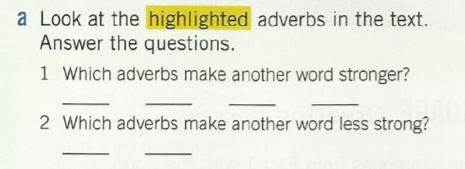
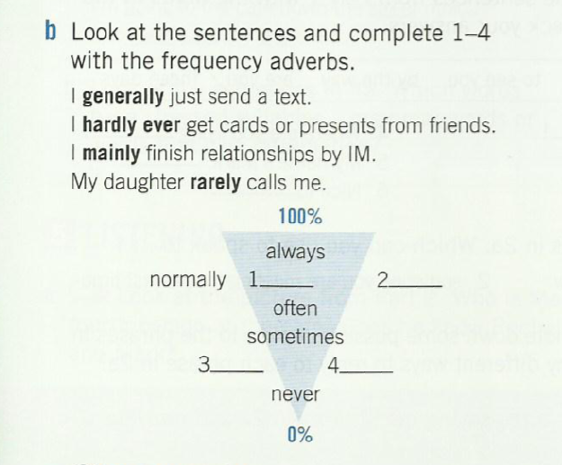
Work on your own
Complete task a and b, page 11

Slide 3
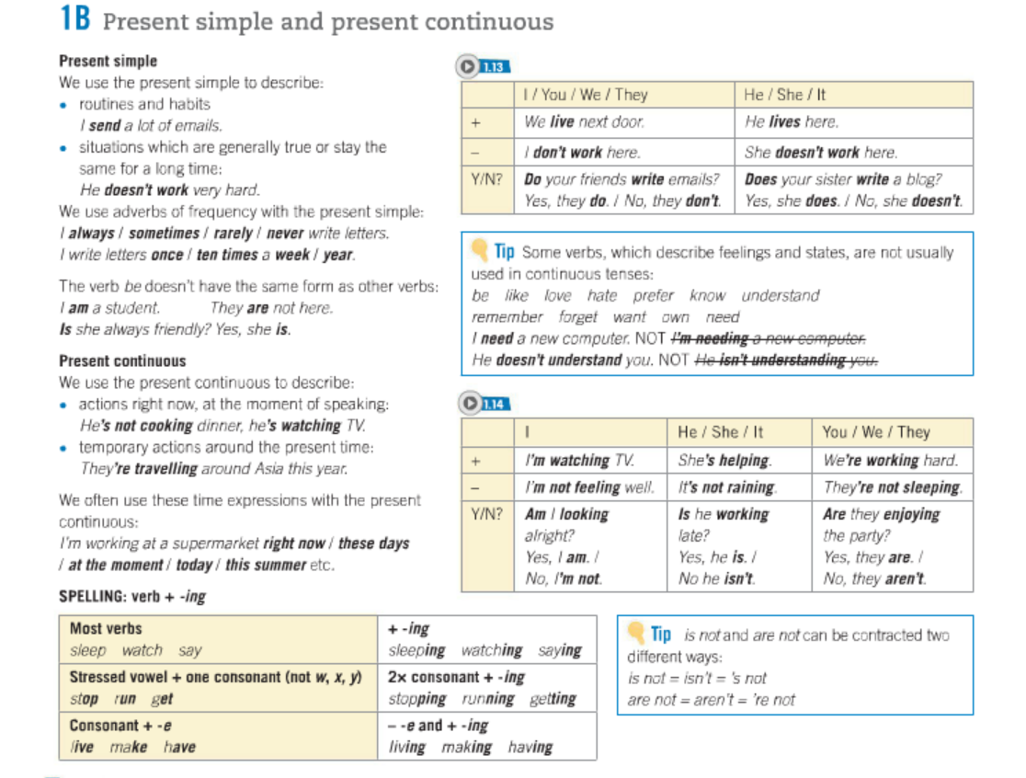

Slide 4
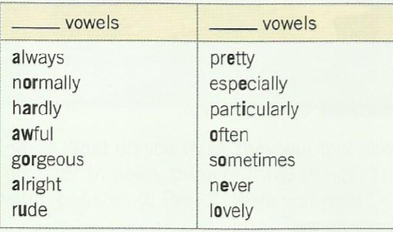
Listen to the audio, decide which ones are long vowels, which ones are short. Write down short and long in the blanks

