Slide 1
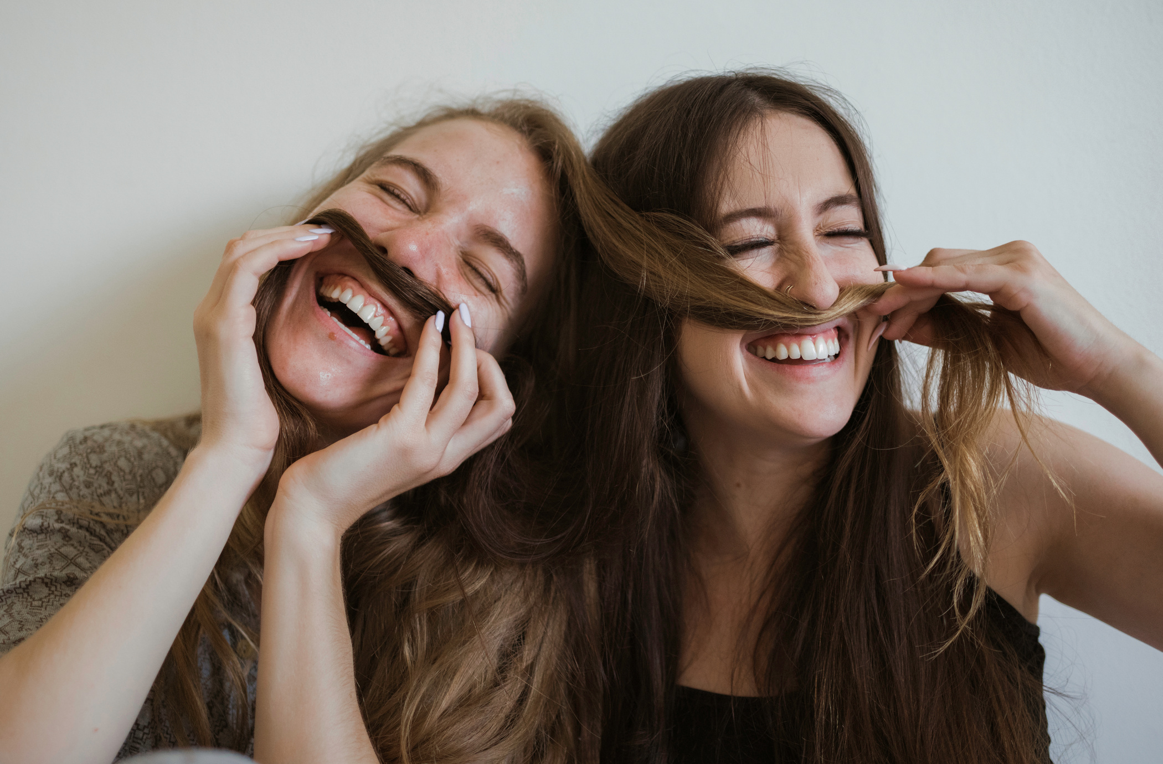
Hi!
COMMUNICATING

Slide 2
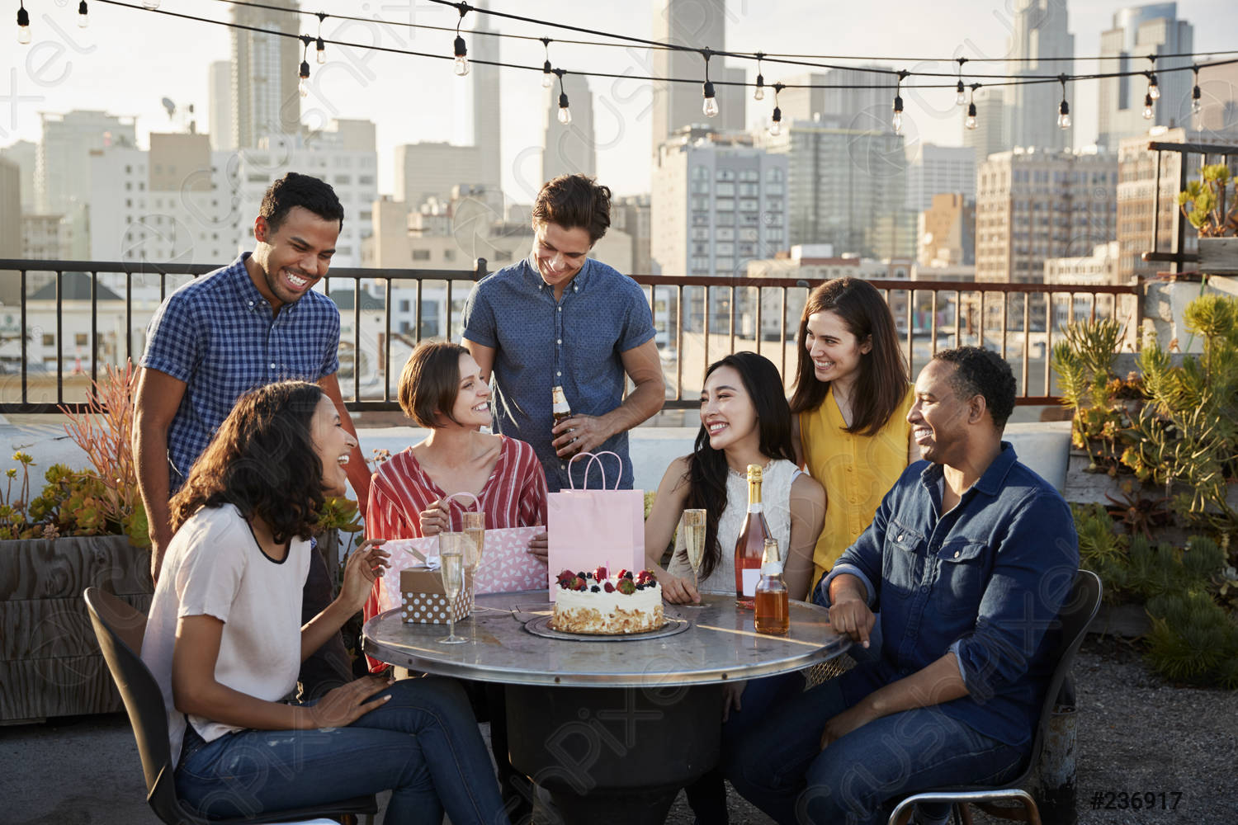
Let’s discuss
- How do people communicate?
How about you? How do you communicate
with others?

Slide 3
Do the survey
What kind of social media are you really into?
https://tesol.lcms.vn/mod/choice/view.php?id=31534
Me first: I am really into Youtube, . I mean I love using it because …..

Slide 4
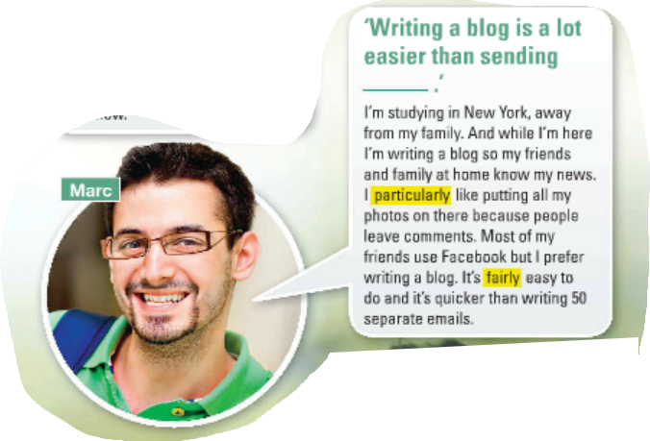
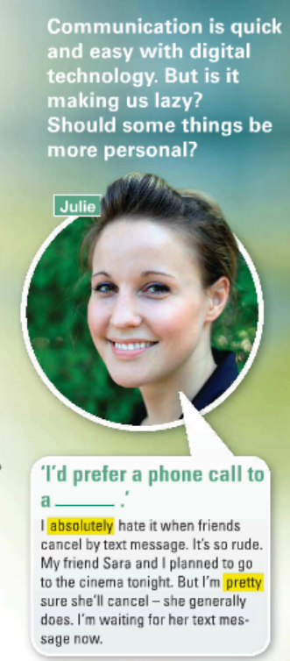
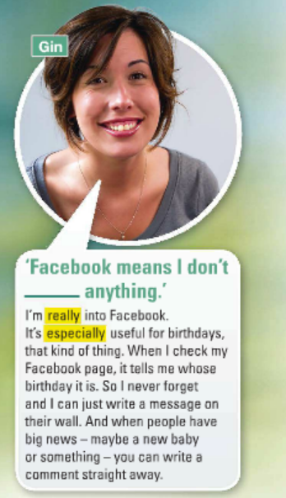
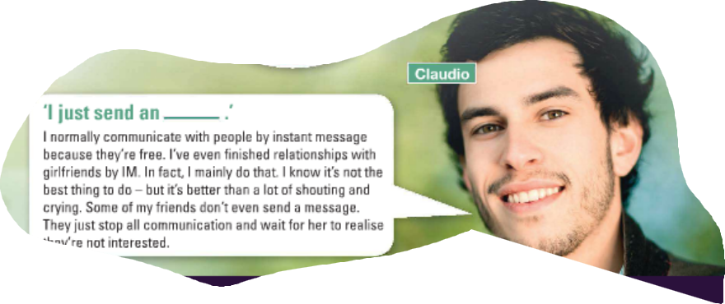
Our reading topic today:
In pairs, guess the missing words

Slide 5
Now, read the text carefully…

Slide 6
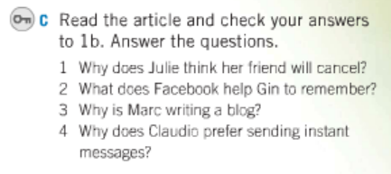
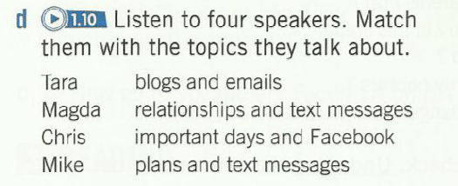
Work in groups, answer these questions

