Slide 1


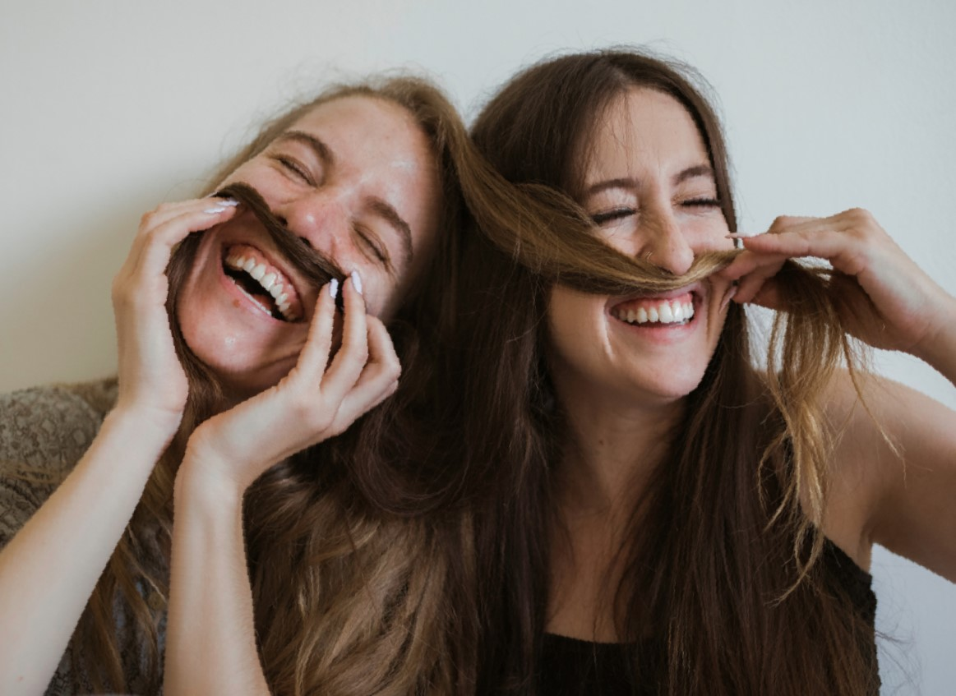



Hi!
COMMUNICATING

Slide 2

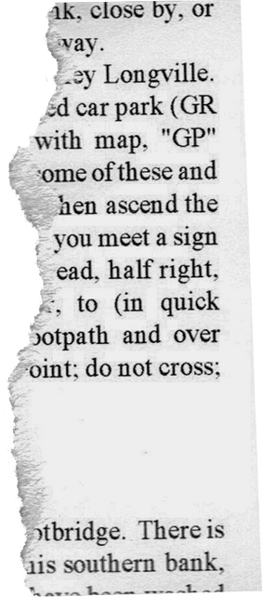



Work in pairs
- Do you think they are meeting for the first time? Why/Why not?
- What events are these people at?

Slide 3


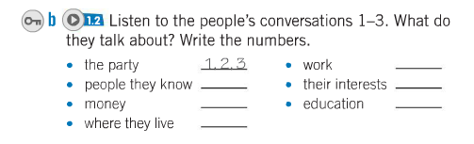




Work in pairs
2
3
1
1
2
1, 2

Slide 4
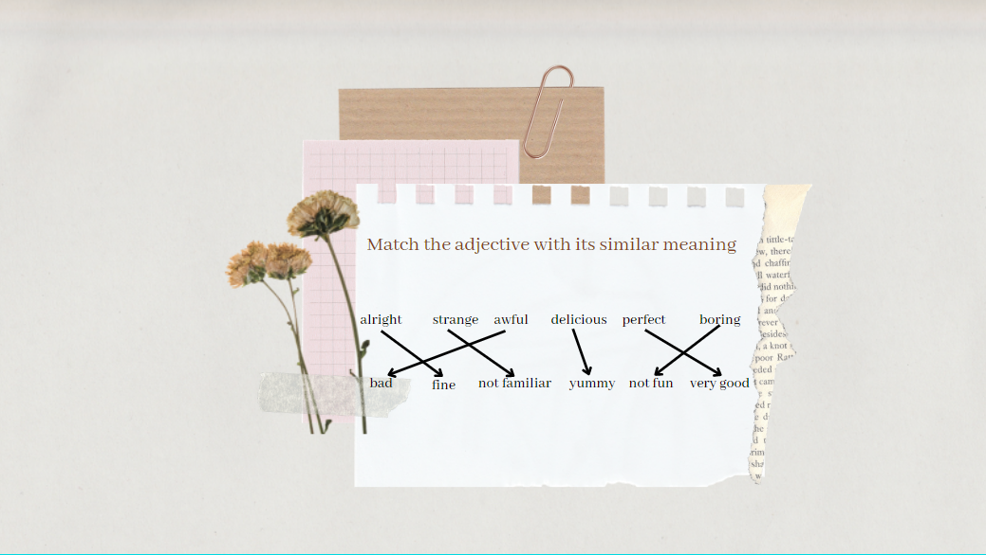

Slide 5
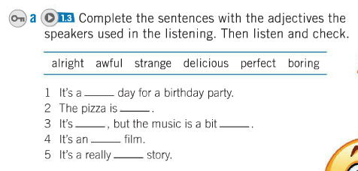

Slide 6

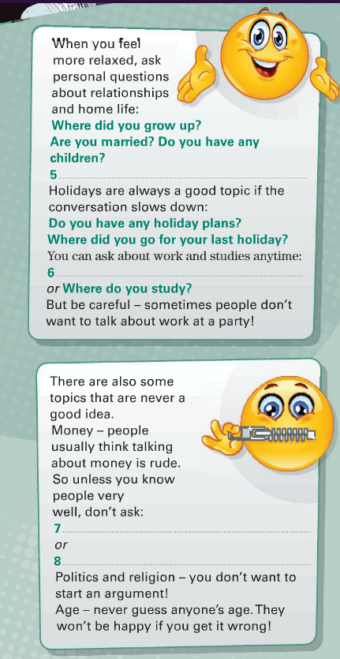
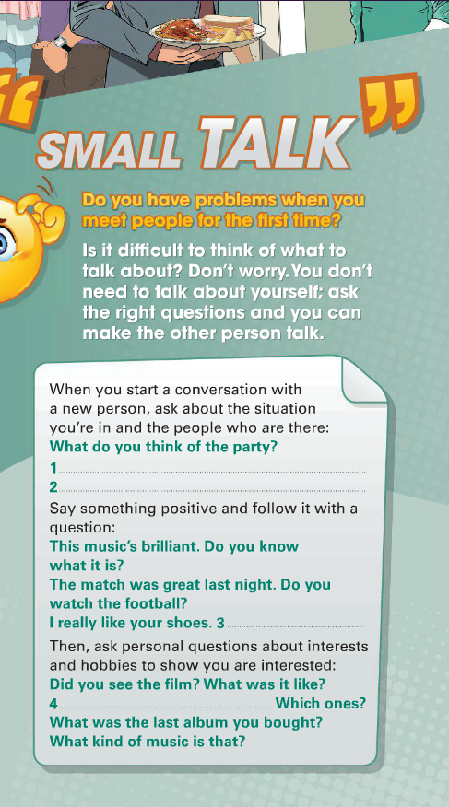
Work in pairs
1
2
1, 2

Slide 7
Questions in the reading
What do you think of the party?
…Do you know what is it?
Do you watch the football last night?
What was the last album you bought?
What kind of music is that?
Where did you grow up?
Are you married?

Slide 8
Questions in the reading
Do you have any children?
…Do you have any holiday plans?
Where did you go for your last holiday?
Where do you study?

Slide 9







Remember, question forms start with ‘-Wh” or “Auxiliaries” (Do, does, did, are, is, was, were) and stops with “?”
Let’s practice!
Get to know your new classmates by asking them questions

