Slide 1
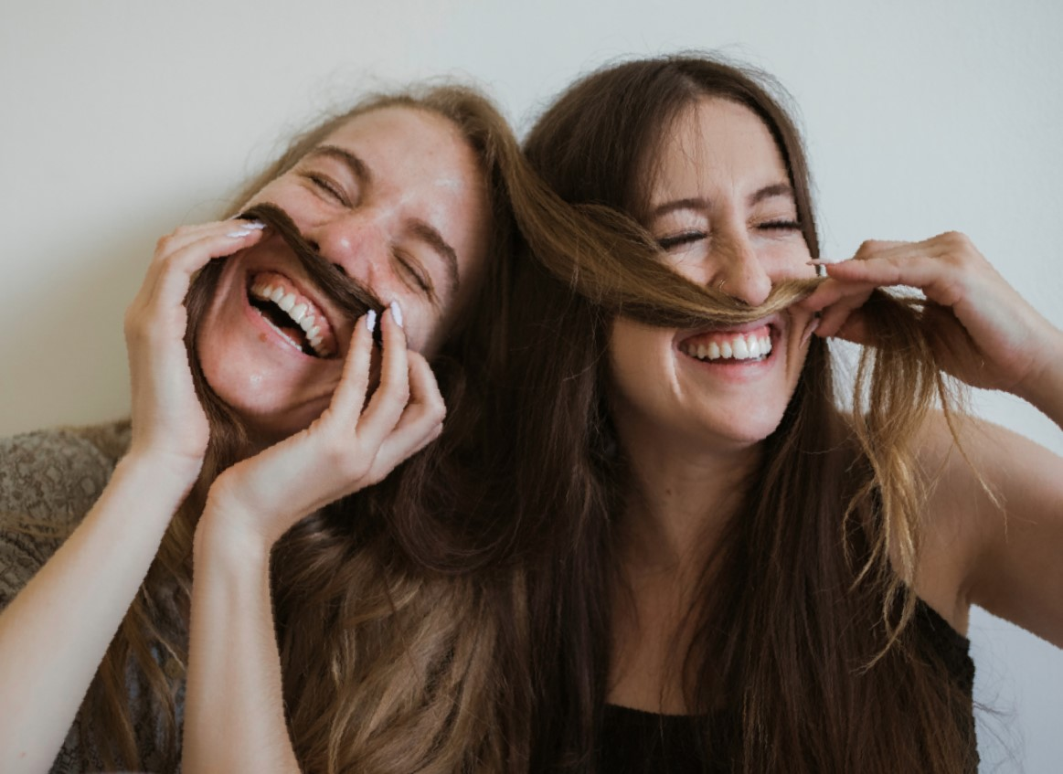
Hi!
COMMUNICATING

Slide 2
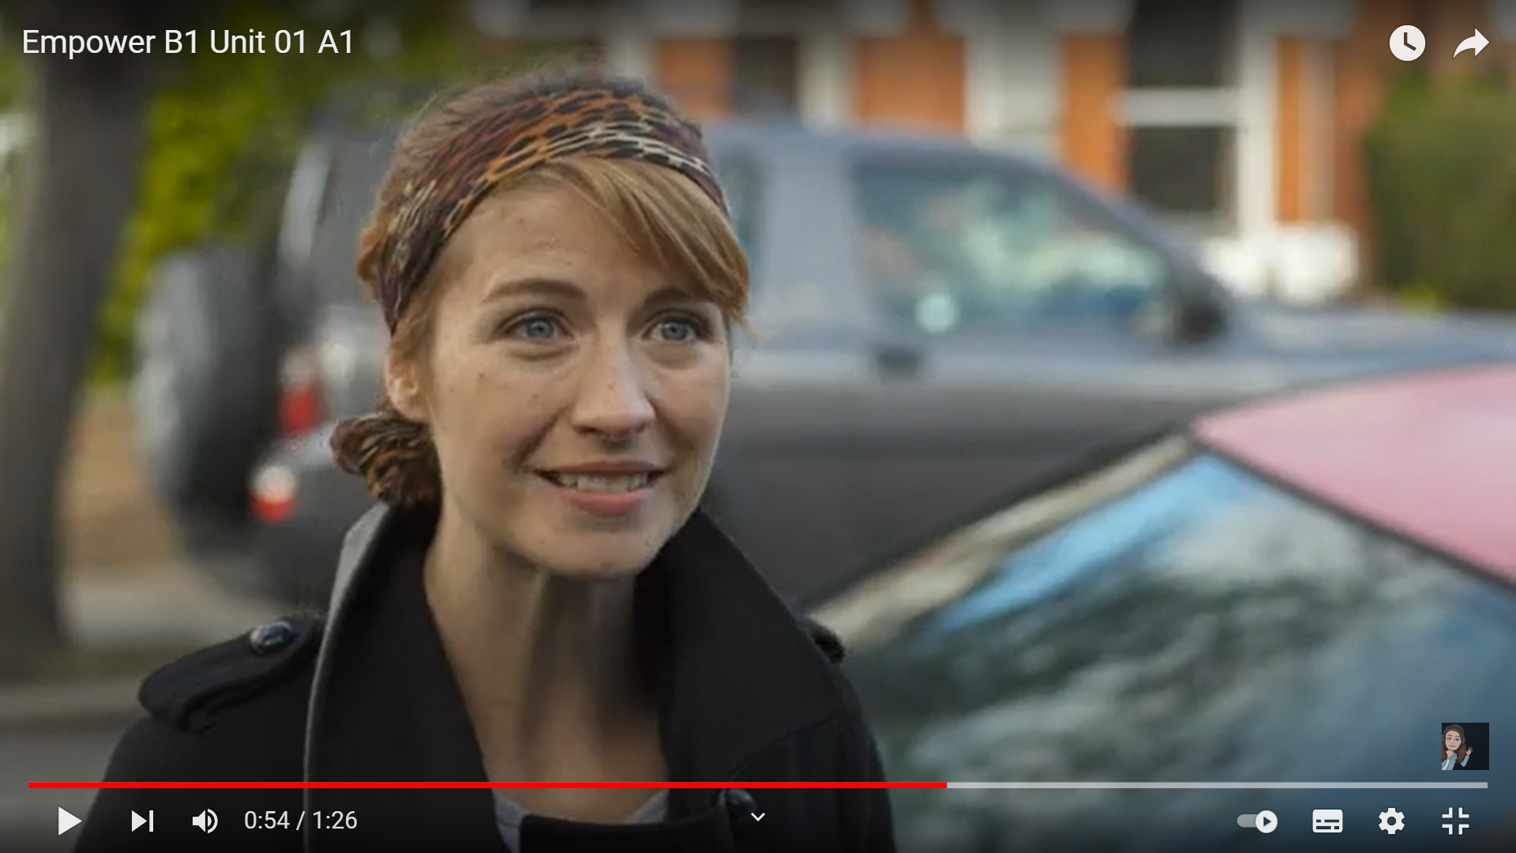
Watch the video again
https://www.youtube.com/watch?v=Fc8Vel_mdJw&t=10s
Do you think people in this video know eacher well? Why?

Slide 3
Tick True or False

Slide 4
lovely
nice
Fantastic
good

Slide 5
To show interest, you use
adjective
adjective
adjective
adjective

